Slide 1
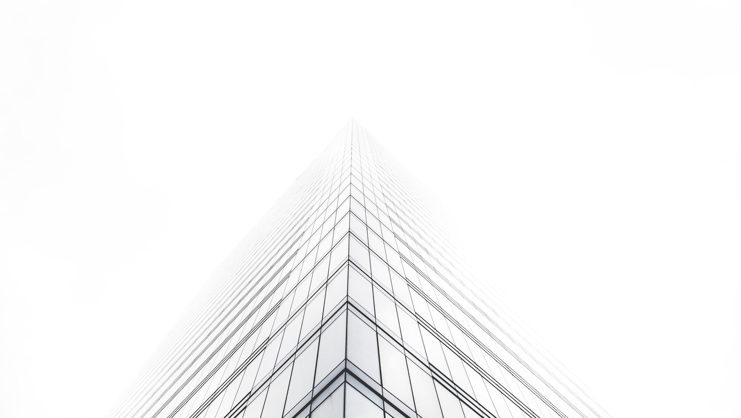


SOH Space
Possible options for SOH Revenue in Proposed Sites.
01

Slide 2
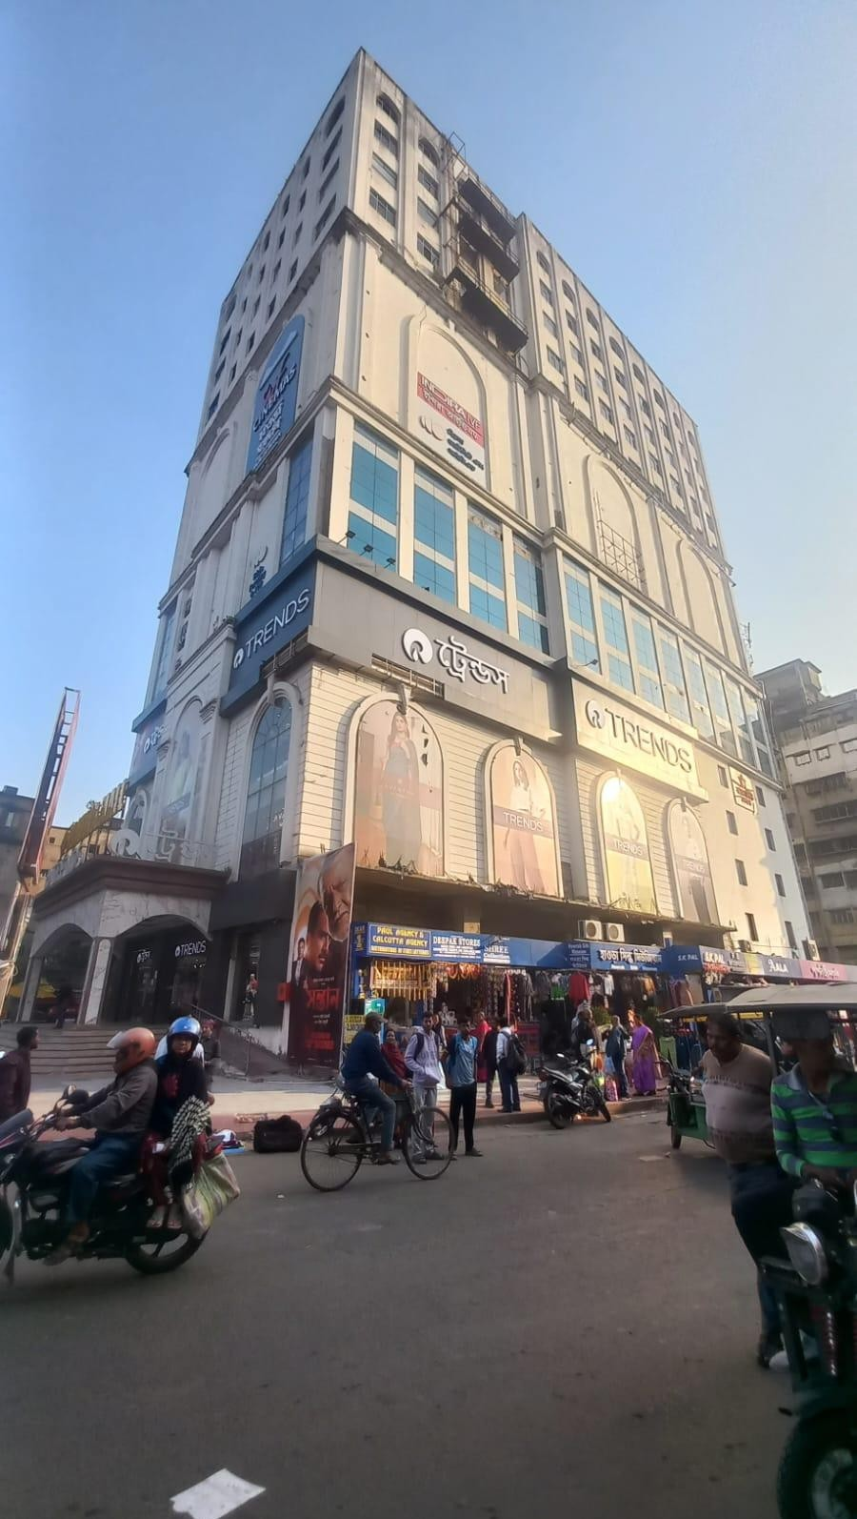
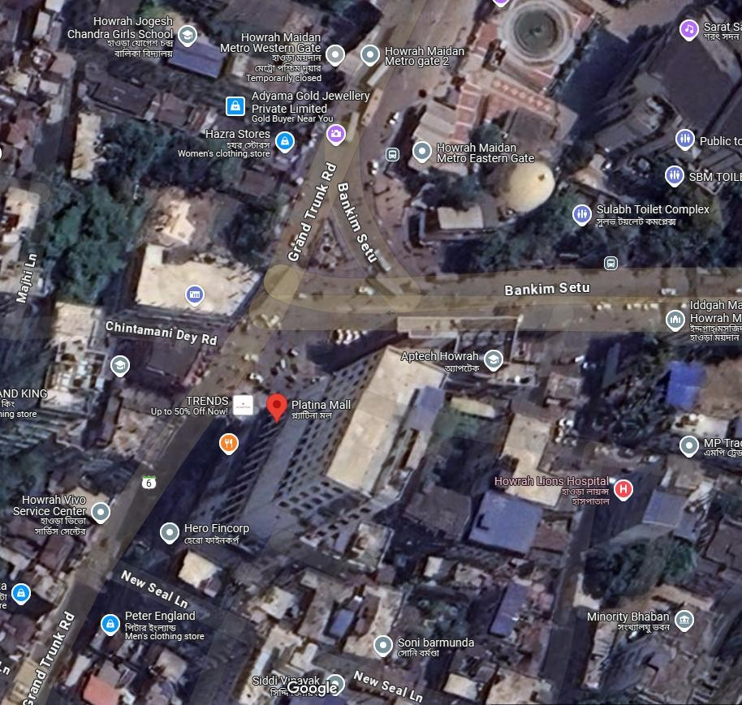
Platina Mall, Howrah
2 way façade view
02
Google Link - https://maps.app.goo.gl/Zm6q9ki3wepBh5UM8

Slide 3
1
2
5
4
3
6
Block No | Width (ft) | Height (ft)
4 | 80’ | 34’1”
5 | 42’11” | 24’11”
6 | 75’9” | 24’11”
Block No | Width (ft) | Height (ft)
1 | 25’3” | 34’3”
2 | 25’3” | 34’3”
3 | 38’4” | 24’7”
03
Sizes are tentative and subject to technical validation.

Slide 4
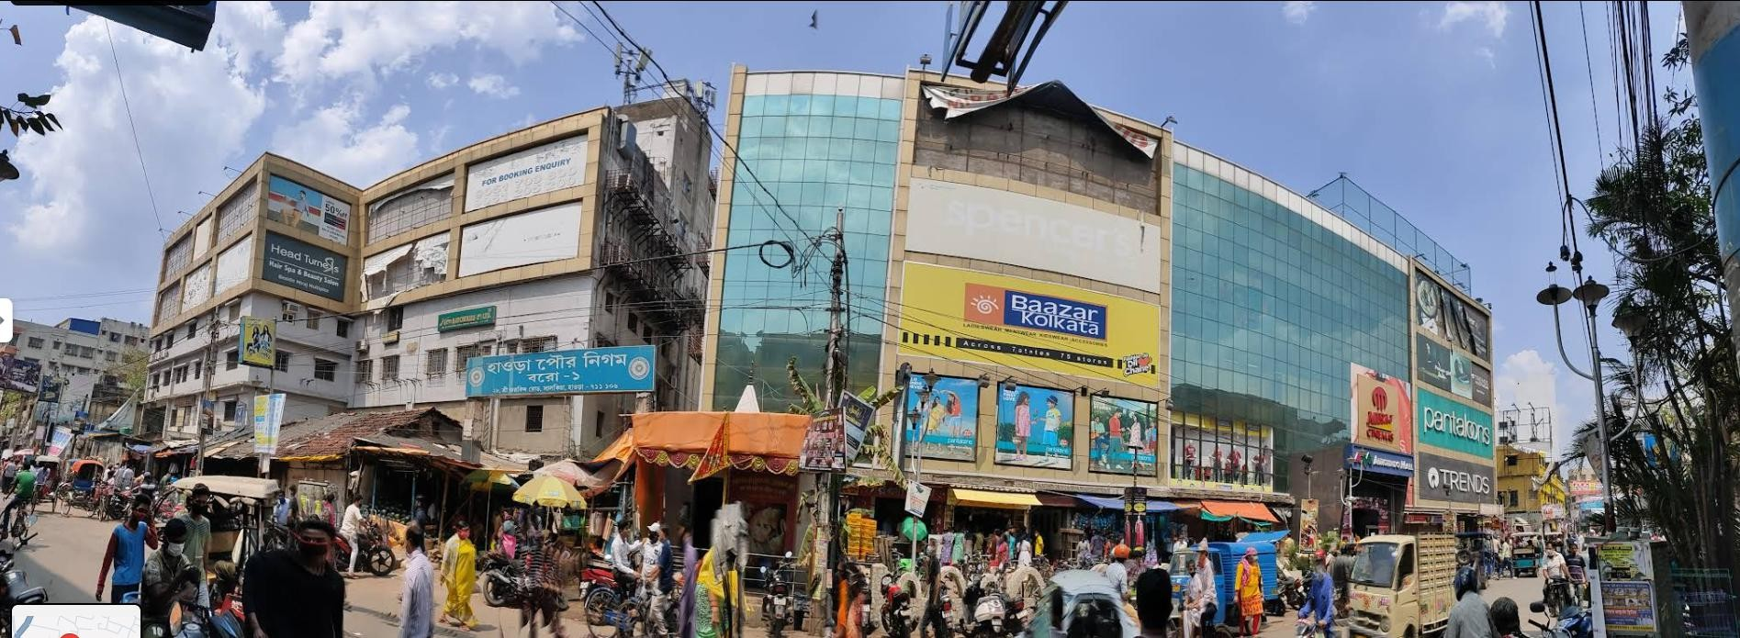
Aurobindo Mall,
Howrah
Mall façade view
Total ….. Ft Road Frontage
04
295’
https://maps.app.goo.gl/2JK5n3b9EFyPy2aVA

Slide 5
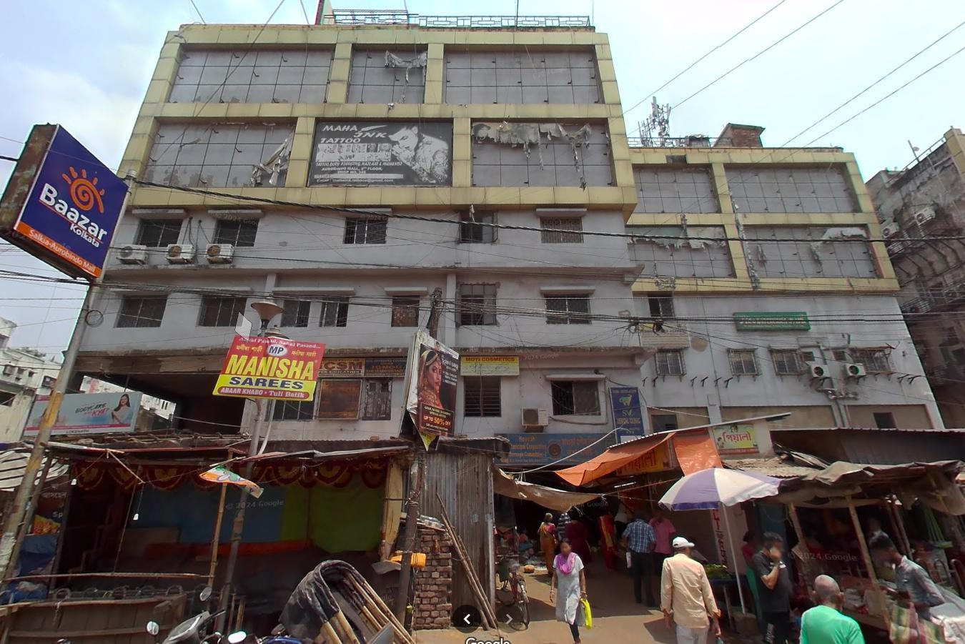
Aurobindo Mall,
Left Wing
Howrah
Block No | Width (ft) | Height (ft)
1 | 20’11” | 10’9”
2 | 11’1” | 10’9”
3 | 21’3” | 10’9”
4 | 18’6” | 10’9”
5 | 17’ | 10’9”
6 | 17’10” | 10’9”
7 | 25’5” | 10’9”
8 | 25’5” | 10’9”
9 | 25’5” | 10’9”
10 | 25’5” | 10’9”
1
2
3
4
5
6
7
8
9
10
05

Slide 6
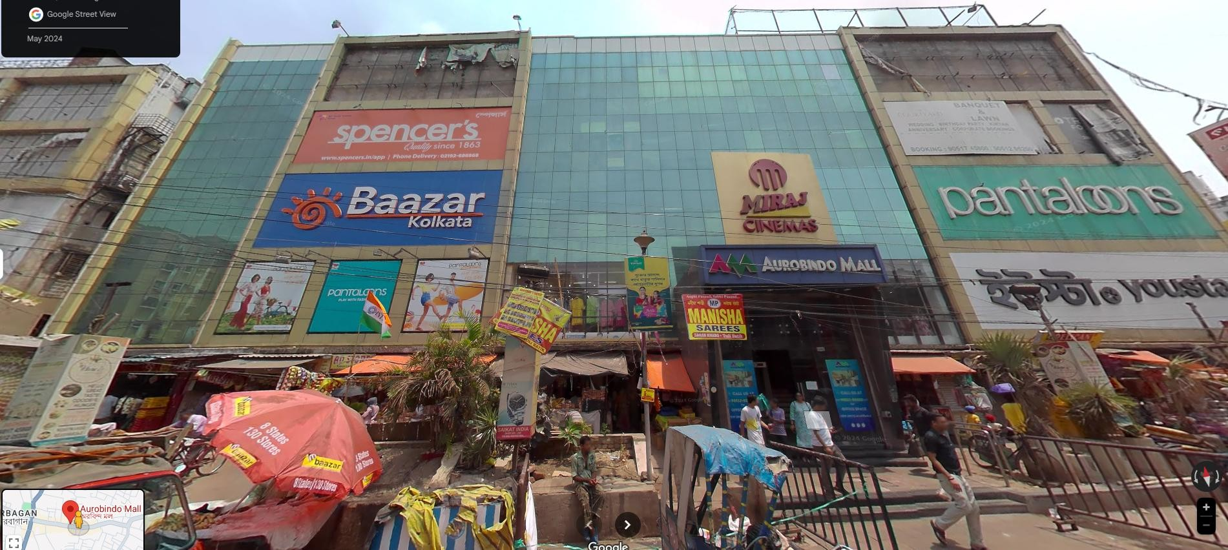
Aurobindo Mall,
Right Wing
Howrah
1 2 3
4 5 6
7 8
₉ 10
04
1
2
5
3
4
Block No | Width (ft) | Height (ft)
1 | 34’5” | 15’3”
2 | 34’5” | 15’3”
3 | 21’4” | 11’4”
4 | 19’6” | 57’6”
5 | 58’6” | 46’

Slide 7
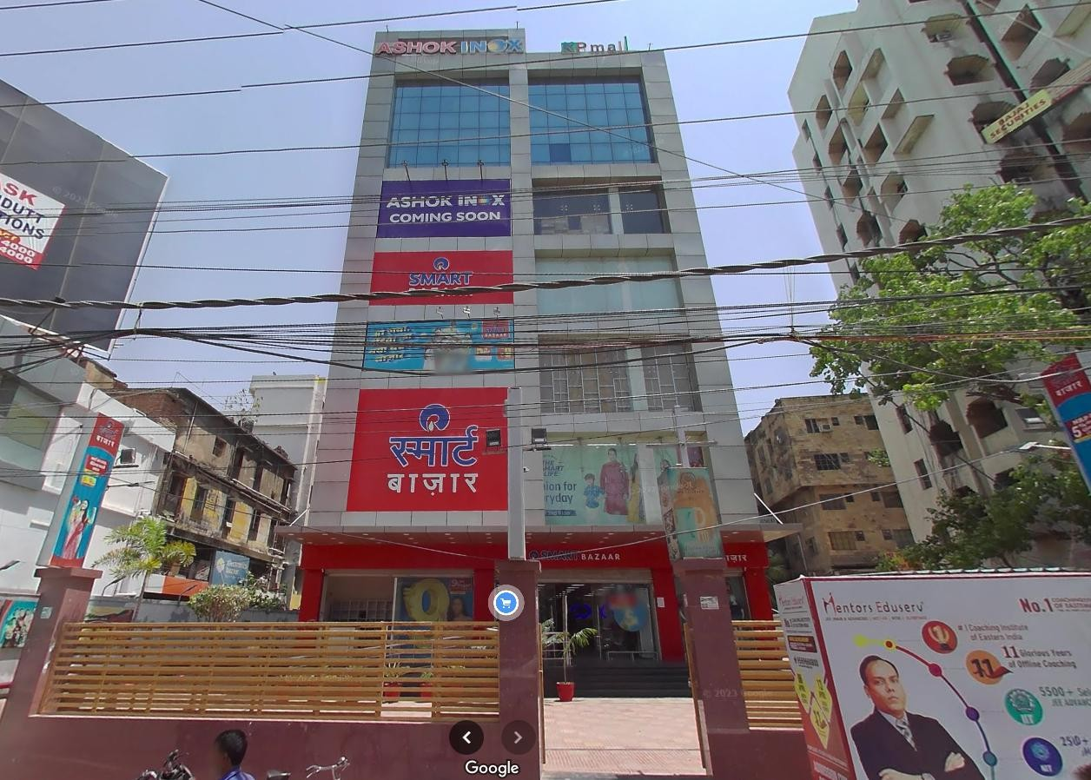
KP Mall, Patna
Mall façade view
07
https://maps.app.goo.gl/5UtBzZJZRSHRxLs87

Slide 8
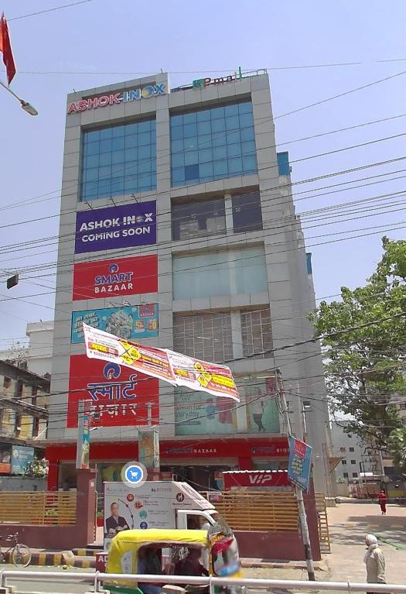
KP Mall, Patna
Block No | Width (ft) | Height (ft)
1 | 19’7” | 11’
2 | 19’7” | 11’
3 | 19’7” | 10’6”
4 | - | -
5 | 19’7” | 22’
6 | 19’7” | 22’
5
6
1
2
3
08

Slide 9

THANK YOU !
DHIRAJ CHABBRIA
Director - Marketing
Email Id : dc@sabmarcom.com
Mobile: +91 98700 79884

